Slide 1
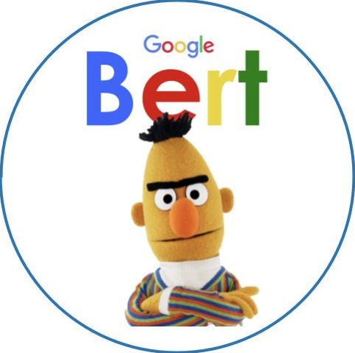



Negation-Aware BERT Fine-Tuning
Anton Dzega
Shahar Oded
Lior Broide
Yuval Haim

Slide 2

Origin
Our work is inspired by the paper “Understanding by Understanding Not”, which aimed at improving BERTS performance when encountering negation in sentences.
Example:
when asked to predict “The capital of Cuba is [MASK]” and “The capital of Cuba is not [MASK]”, BERT often generate the same answer “Havana”.
Proposal:
Generate negated versions of factual or generic sentences using syntactic rules.
Identify a word in the negated sentence that should be unlikely if the original (positive) sentence is true.
Penalizing BERT during training if it assigns high probability to that word when predicting from the negated sentence — this is the unlikelihood loss.
Combining this with knowledge distillation so the model doesn’t forget how to behave on regular, non-negated sentences.

Slide 3

Our Goal
We propose to:
Fine-tune BERT using negation-augmented TE datasets, where hypotheses include negated statements.
Adapt QA pairs (e.g., from SQuAD 1.1 ) into TE-style pairs (e.g., turning questions into hypotheses) to further enrich the fine-tuning data (alternative augmentation).
Evaluate the impact of this fine-tuning on general TE performance and on the ability to correctly handle the negated samples.

Slide 4

Conversion of QA to TE-style Pairs
QA to TE:
A pair is considered an “Entailment” if the answer is included within the question (specific to SQuAD 1.1) – based on common methods. Else – contradiction.
TE to Negated TE:
For every entity within the premise (using SpaCy), if the entity is in the hypothesis, replace with “not X” and change label to contradiction.
In addition, samples were turned to negation by replacing the entities within the hypothesis with random entities.

Slide 5



Negation Augmentation Methods
Two negation augmentation are performed:
For resources concerns the base dataset is always ~100K records, and the augmentation adds an additional 30-40K records.
Spacy Augmentation - designed for the SQuaD TE pairs, is the "lighter" baseline method, injecting negation into answers and replacing entities in entailment pairs turning them into contradiction.
LLM Augmentation – TE pairs are passed through an instruct LLM engine (gpt-4o-mini) that creates an alternative hypothesis, neutrally grammerd, negated to the original pair.

Slide 6





Projects Pipeline
Data preparation:
Obtain TE datasets (MNLI & SNLI) -> Add & Convert QA into TE style pairs -> Negate datasets
Create dataset subsets
Train
- Baseline: MNLI+SNLI (~100K train, ~20k val)
- Spacy Augmented: MNLI+SNLI+SQuaD (as TE) with augmentation on SQuaD (~135K train, ~26k val)
- LLM Augmented: MNLI+SNLI with LLM augmentation on all entailment pairs (~135K train, ~26k val)
Test
- MNLI+SNLI with augmentation on all entailment pairs (~23k)
Fine-tune BERT for entailment classification (3 models).
Evaluation

Slide 7

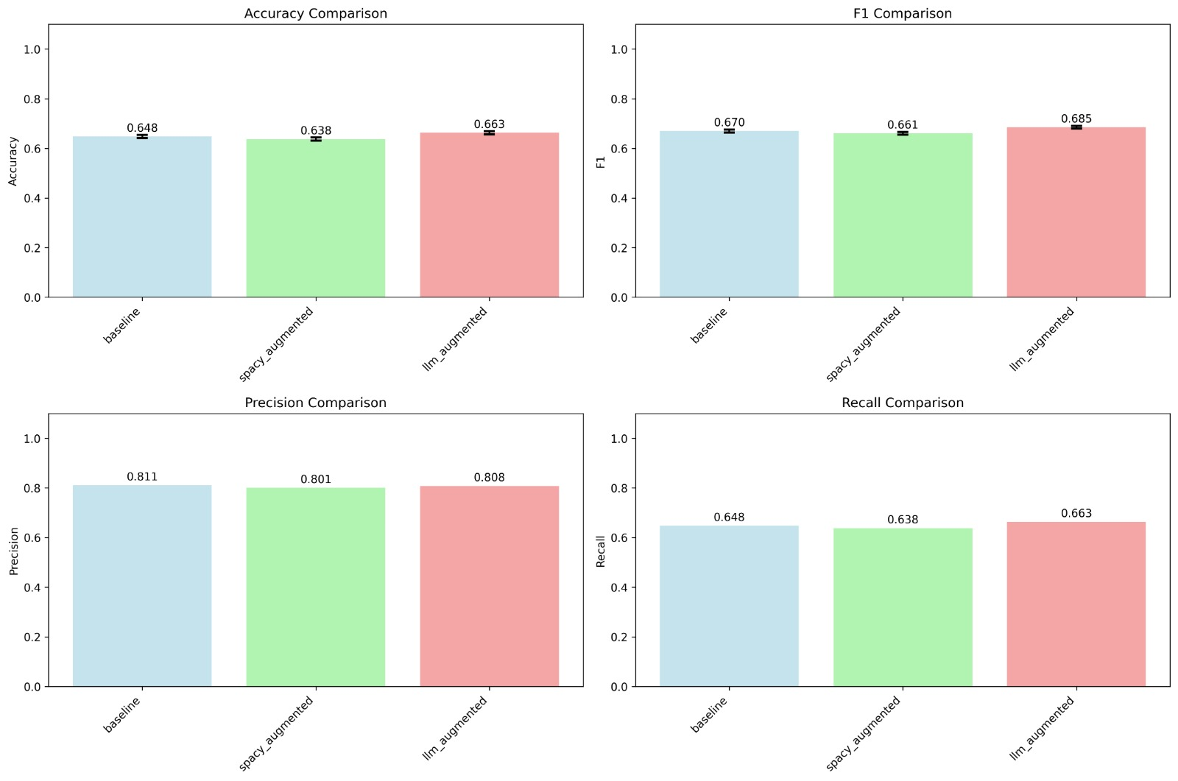
Results
Accuracy
F1 Score
Notes:
Summery:
Spacy augmentation worse than baseline (Spacy < Baseline) across the board.
LLM augmentation better than baseline (LLM > Baseline) in Accuracy/F1/Recall/ slightly falling behind in Precision.

Slide 8
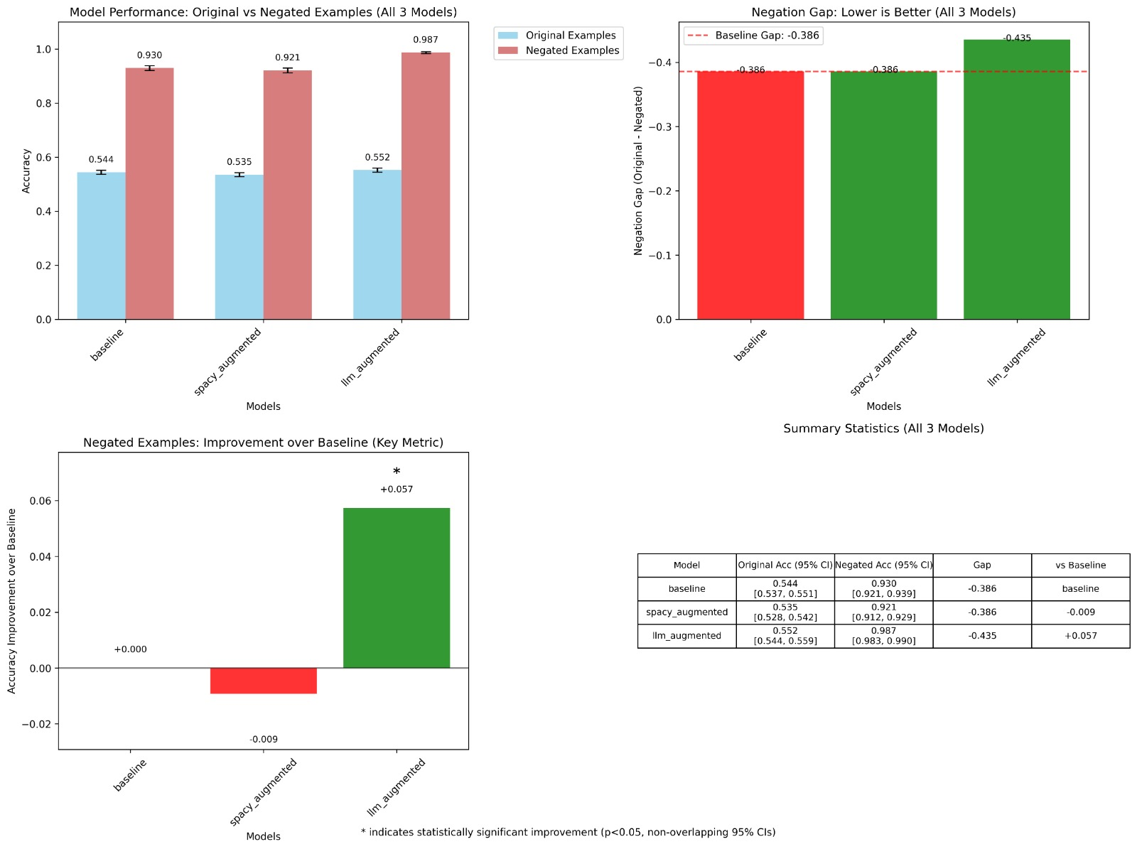
Results
Original Examples: original test set dataset with no augmentation (additional negated examples)
Original Examples: augmented negated examples dataset created from original examples.
Notes:
Summary:
When comparing performance on the two subsets of the test set: original examples & negated examples (created using an augmentation):
Model trained on negated examples created using an LLM, improved accuracy on the negated examples and even on original examples slightly.
Model trained on negated examples created using the spacy method, performed worse on both negated and original examples.
Note: LLM results achieved significant accuracy improvement over baseline with p_value < 0.05

Slide 9

Next Steps
So, fine-tuning is not a bad alternative to heavy, expensive and complex pre-train, is it?
Next:
Better SQuAD Augmentation: Tighter augmentation may yield better results (potentially combined with the LLM augmentation).
Additional Baseline Models: RoBERTa maybe?
Additional Tasks: Attempting the same augmentation methods on purely QA tasks
Notes:
Time: 7h end-to-end compared to days to weeks for a BERT base pre-training.

Slide 10

Thank You

